Slide 1
INVESTMENT ASSIGNMENT SUBMISSION
Name: Ambareesh Balisetty

Slide 2
Objective & Goals
Objective :
To identify the best sectors, countries, and a suitable investment type for making investments. The overall strategy is to invest where others are investing, implying that the 'best' sectors and countries are the ones 'where most investors are investing’.
Goals :
Find the best investment type in between 5-15M range
Find the top 3 English speaking countries for the selected investment type
Find the top 3 sectors for each country in top 3 list.

Slide 3
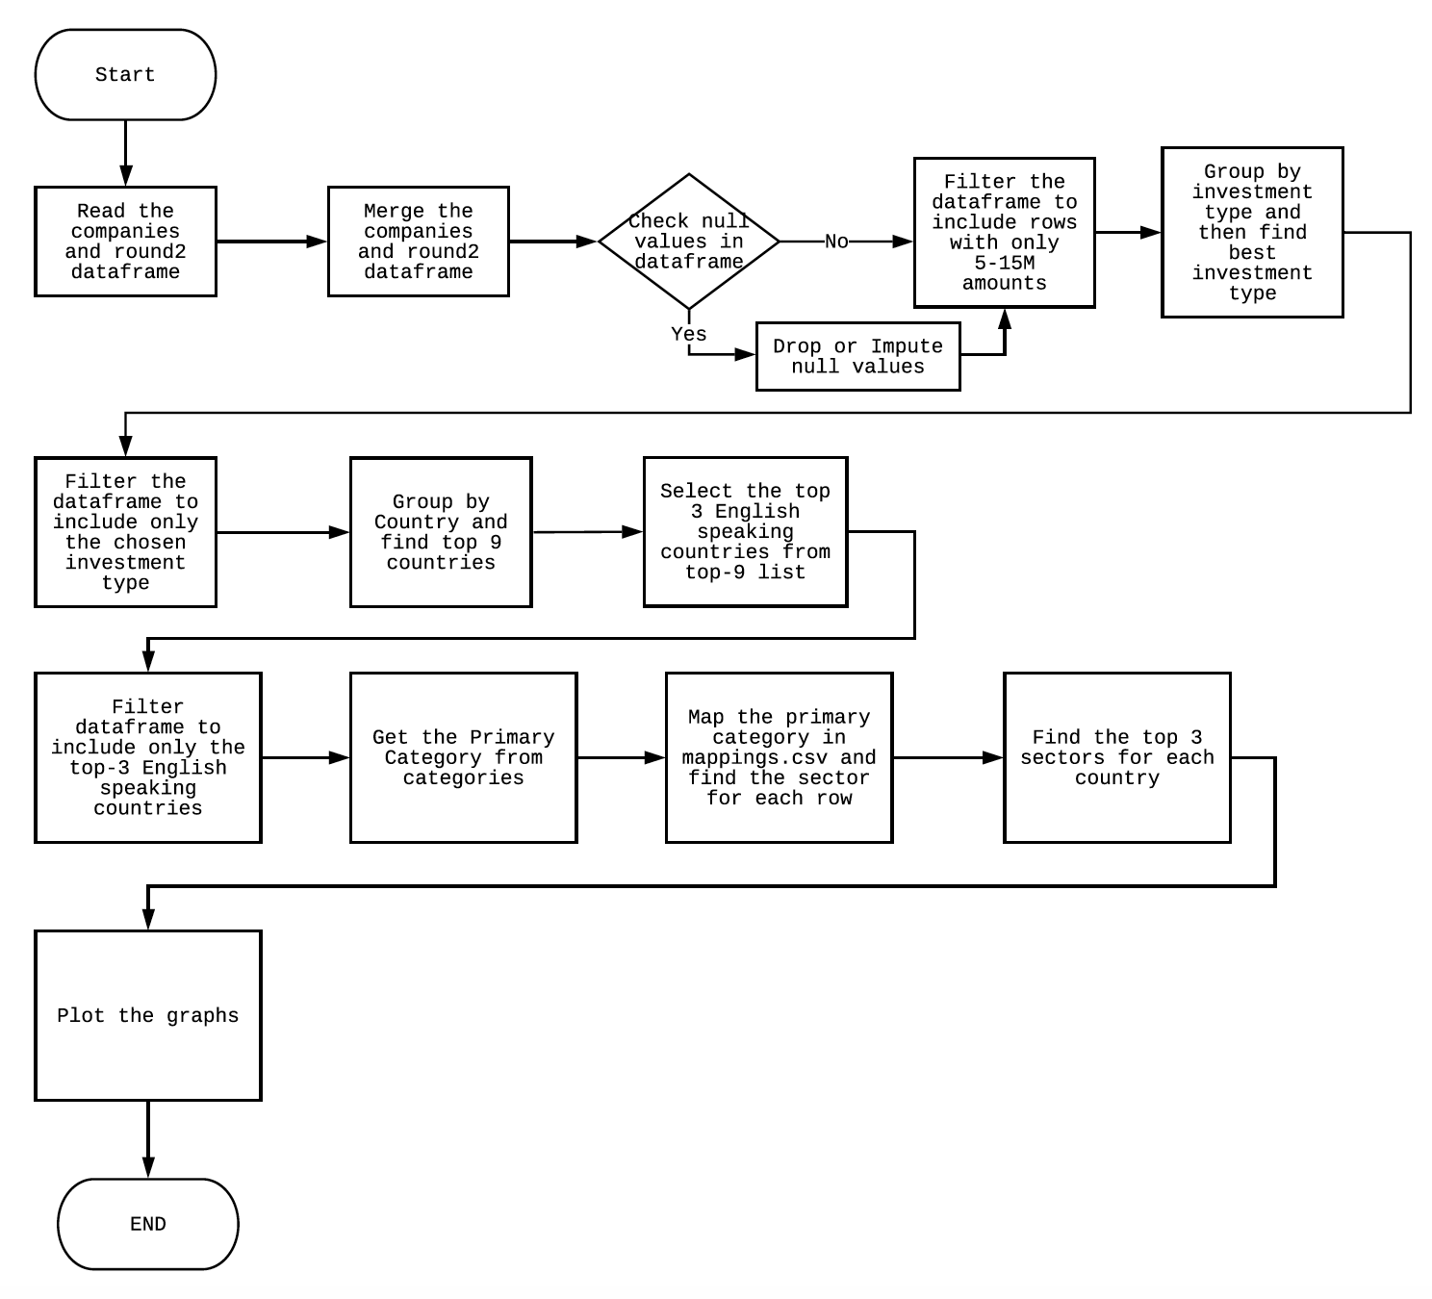
<Problem solving methodology>
Use flow chart

Slide 4
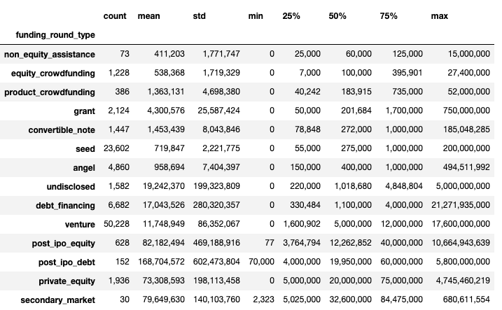
Investment Type
Venture is the most suitable invest type as the median is in 5-15M range.
This investment type also has a maximum number of values in this range (16,598). The second one, debt_financing has only 870 values in this range.

Slide 5
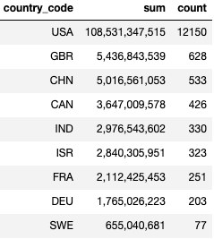
Top 9 Countries
The top 9 countries for Venture funds with 5-15M investment range are :
United States of America – English speaking country
Britain – English speaking country
China – Non-English speaking country
Canada – English speaking country
India – English speaking country
Israel – English speaking country
France – Non-English speaking country
Germany – Non-English speaking country
Sweden – Non-English speaking country
* Interesting Note : If the range, 5-15M is ignored, Canada and India exchange their places.

Slide 6
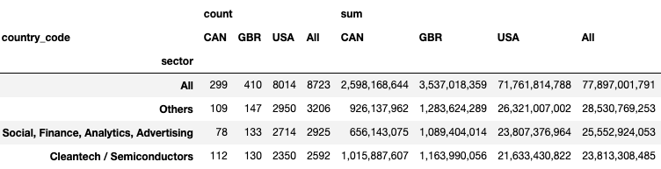
Top Sectors Across Top 3 Countries
US & GB have their top 3 sectors as follows :
Others
Social, Finance, Analytics, Advertising and
Cleantech / Semiconductors
Whereas CA has
Cleantech / Semiconductors
Others
Social, Finance, Analytics, Advertising and

Slide 7
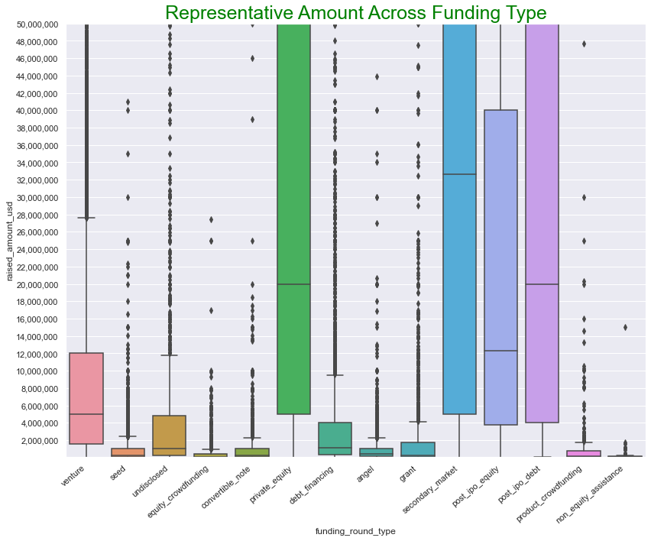
Investment Type - 1
This box plot clearly depicts that venture is the only funding type that satisfies the condition of investment amounts in range of 5-15M.

Slide 8
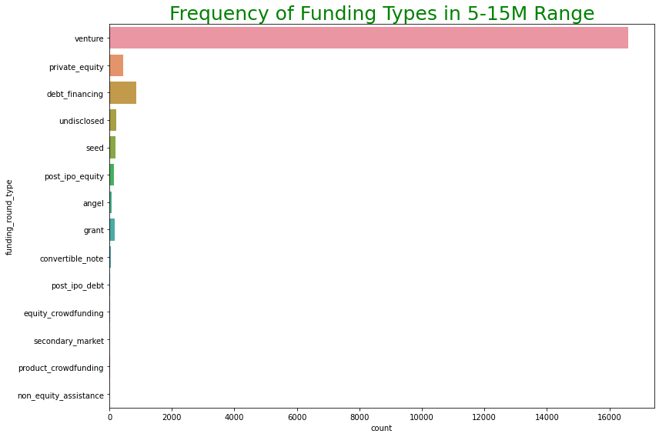
Investment Type - 2
This chart shows that 5-15M investment range has mostly Venture funding type and it reinforces that Venture is the BEST funding type for our company.

Slide 9
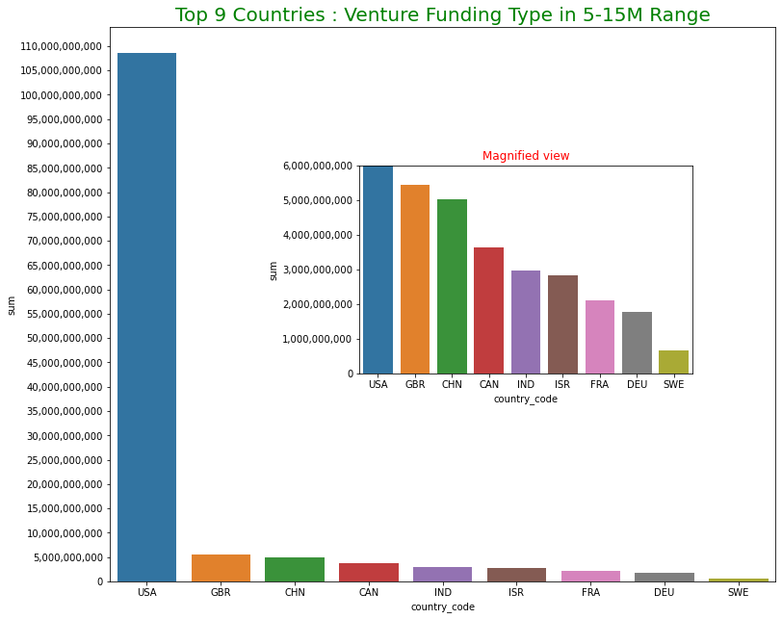
Top 3 Countries
This chart shows that top three venture funding, English speaking countries are
USA
GBR and
CAD

Slide 10
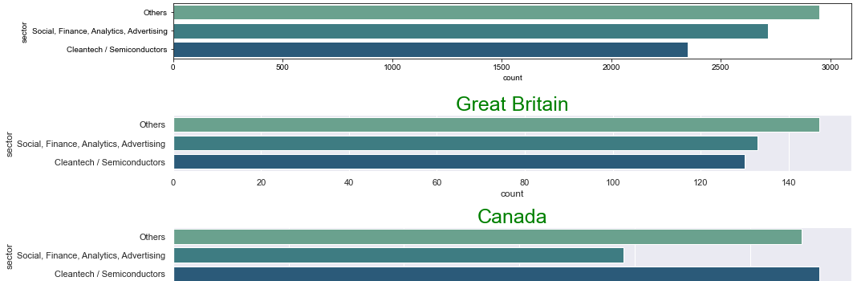
Top 3 Sectors
Rank | USA | GBR | CAN
1 | Others | Others | Cleantech / Semiconductors
2 | Social, Finance, Analytics, Advertising | Social, Finance, Analytics, Advertising | Others
3 | Cleantech / Semiconductors | Cleantech / Semiconductors | Social, Finance, Analytics, Advertising

Slide 11
Conclusion
USA represents 92% of investments, followed by GBR with 4% and CAN with 3%.
67% investments are in top 3 sectors. For CAN, it even increases to 71%
Chosen Investment Type : Venture
Top 3 Countries : USA, GBR and CAN
Top 3 Sectors in no particular order :
Others
Social, Finance, Analytics, Advertising
Cleantech / Semiconductors
Recommendation is to concentrate in US with the sectors as “Others”, “Social, Finance, Analytics, Advertising” and “Cleantech / Semiconductors”

Slide 12


